Slide 1

SOCCER SOCIETY The one shop for your soccer needs
Fidele Donadje

Slide 2

Business Concept
A shop for all your soccer needs
What is Soccer Society?
Retail and online soccer store
sell and customize soccer gear
ultimate store for soccer fans
Why?
lack of soccer stores
Rising popularity of soccer
increase of soccer culture

Slide 3
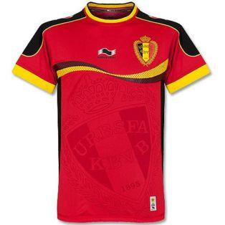
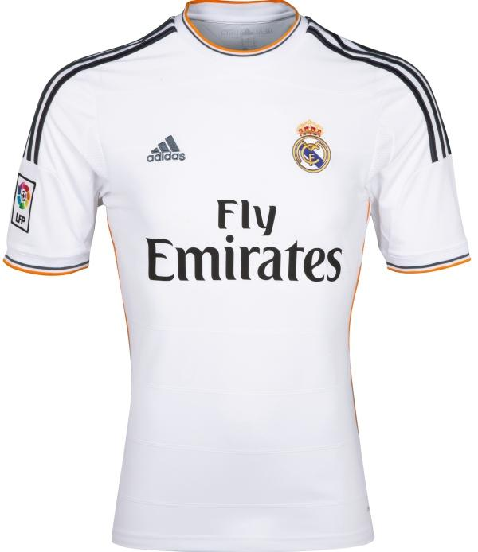
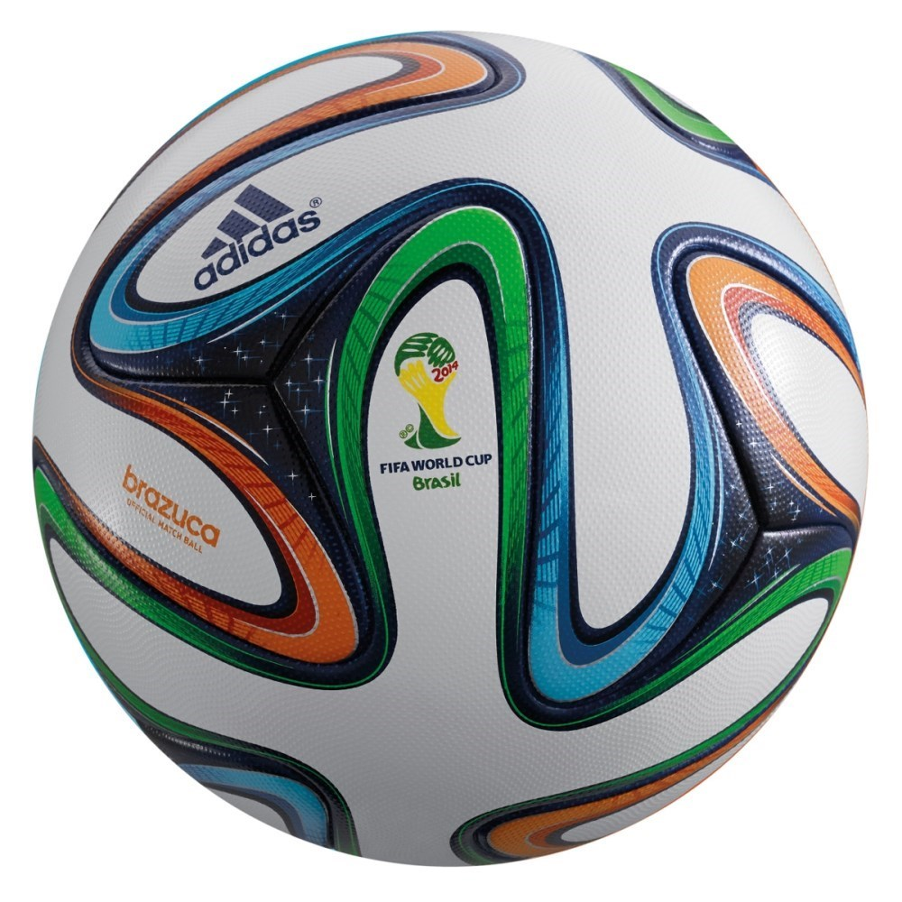
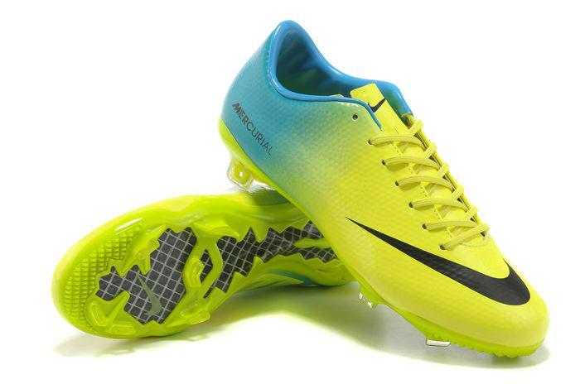
WHAT WE SELL
Jerseys:
Official
Customized
Soccer Gear:
Cleats
Soccer nets
Soccer balls
Memorabilia
Backpacks
Custom and team soccer balls

Slide 4
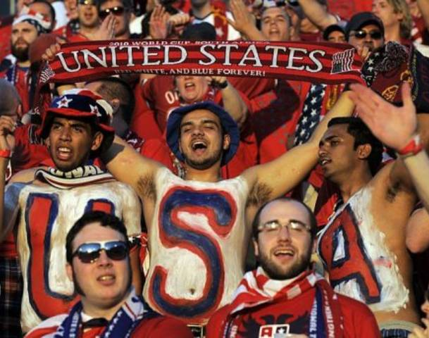
CUSTOMERS & LOCATION
International population
International students/Exchange students
Tourists,
workers
People interested in soccer
locals
students
Schools, companies looking for soccer gear
Potential Locations Include
Center City
University City
King of Prussia

Slide 5


INDUSTRY
Industry definition: online and retail store providing beginner level to professional level soccer equipment as well as custom made items such as jerseys, memorabilia for organisation
Competitors
Soccer.com
Dicks
Onionbag.com
World Soccer Shop

Slide 6

Timeline
Open in May 2016 for the Euro
Attract investors (July 2014 - June 2015)
Register business, find property (Summer 2015)
Apply for permits/licences, store layout, (Fall 2015)
Contact manufacturers, renovate property (Winter)
Ad campaign, order inventory (April 2016)
Grand opening of Soccer Society (May 2016)

Slide 7
Basic Income statement
Sales Forecast
Year | 2015 | 2015 | 2016 | 2016 | 2017 | 2017
Jerseys | $90 - 3650 | 328500 | $100 - 4000 | 400000 | $110 - 4200 | 462000
Gloves | $15 - 730 | 10950 | $17 - 800 | 13600 | $19 - 850 | 16150
Shorts | $20- 1825 | 36500 | $22 - 2000 | 44000 | $23 - 2100 | 48300
Goals | $30 - 365 | 10950 | $35 - 400 | 14000 | $37 - 450 | 16650
Balls | $25 - 2920 | 73000 | $30 - 3100 | 93000 | $33 - 3200 | 105600
Cleats | $120 - 2190 | 262800 | $130 - 2500 | 325000 | $130 - 2600 | 338000
Socks | $10 - 1825 | 18250 | $11 - 2000 | 22000 | $12 - 2050 | 24600
Others |  | 100000 |  | 110000 |  | 115000
Total |  | 840950 |  | 1021600 |  | 1126300
Expenses
Jerseys | 60 | 219000 | 70 | 280000 | 75 | 315000
Gloves | 10 | 7300 | 11 | 8800 | 13 | 11050
Shorts | 12 | 21900 | 13 | 26000 | 14 | 29400
Goals | 25 | 9125 | 27 | 10800 | 28 | 12600
Balls | 20 | 58400 | 23 | 71300 | 25 | 80000
Cleats | 100 | 219000 | 110 | 275000 | 125 | 325000
Socks | 7 | 12775 | 7 | 14000 | 8 | 16400
Others |  | 70000 |  | 75000 |  | 90000
Total |  | 617500 |  | 760900 |  | 879450

